Slide 1


MAY 2023
DATA SCIENCE ON SUBSCRIPTION SERVICE.
DataLab Analytics Work Experience and Certification Project.
A DATA ANALYSIS PORTFOLIO
PREPARED BY
GLADYS GBENGA-OJO
GITHUB LINK

Slide 2

PROJECT DESCRIPTION
This project is to analyze raw data for behavioral patterns and forecast metrics for DataLab Analytics' projected subscription platform to be launched into the Nigerian market.
DataLab Analytics will utilize this project's preliminary discovery on a sample benchmark dataset similar to some of the ones gotten from their platform.
The project Dataset “actions2load.csv”, a book subscription platform that contains raw data on customer behavioral activities performed by subscribers on a live-book website which were captured. The Dataset will be cleaned, processed, and prepared for investigatory analysis to discover customer use patterns.
Customer behavior will be analyzed using Python and MySQL Database.

Slide 3
DATA DESIGN
The Dataset is a “CSV” file that contains a list of users interacting with a platform (live-book) that involves reading and accessing digital books or content.
Each row contains information about a single event, including the user's account ID, the time at which the event occurred, the type of event, the product_id, and additional data.
BREAKDOWN OF THE INFORMATION IN EACH COLUMN:
account_id: This column contains a unique identifier for each user who performed an event.
event_time: This column indicates the time at which each event occurred. The times are given in a format that includes hours, minutes, and seconds.
event_type: This column specifies the type of event that occurred. Examples of possible event types in this table are:
DashboardLivebookLinkOpened: A user opened a link to a live-book from their dashboard.
ReadingOwnedBook: A user started or continued reading a book they own.
ProductTocLivebookLinkOpened: A user opened a link to a live-book from a product table of contents.
ReadingOpenChapter: A user opened a specific chapter of a book they are reading.
product_id: This corresponds with the event_type.
additional_data: This metric may not be needed in this project.

Slide 4


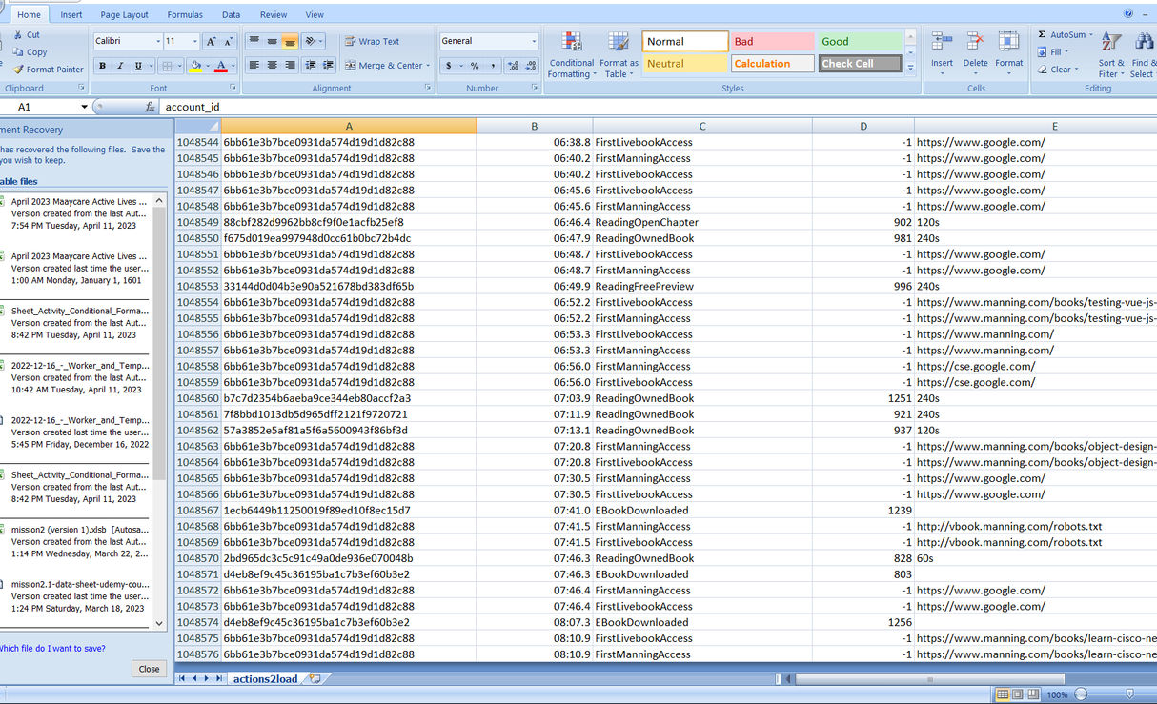
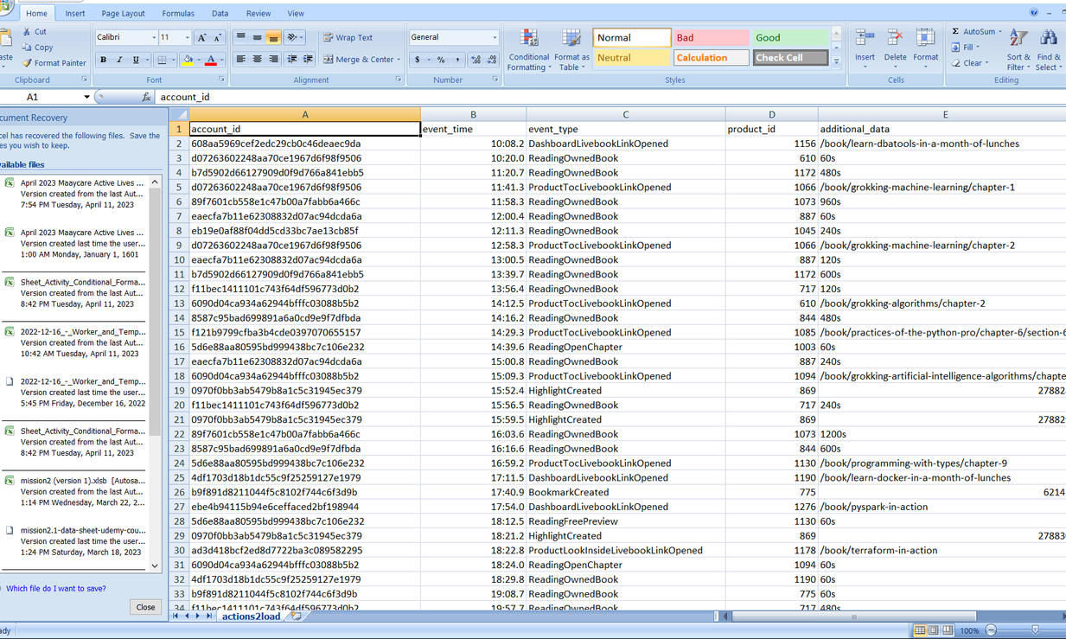
design -findings-analysis
1. Opening the CSV data in Microsoft Excel:
The dataset contains millions of rows which is beyond what Microsoft Excel can handle.
Microsoft Excel rendered five columns and 1,048,575 rows. There were no missing row values in the first four columns,
however, the additional_data column has 234,014 missing row values.

Slide 5
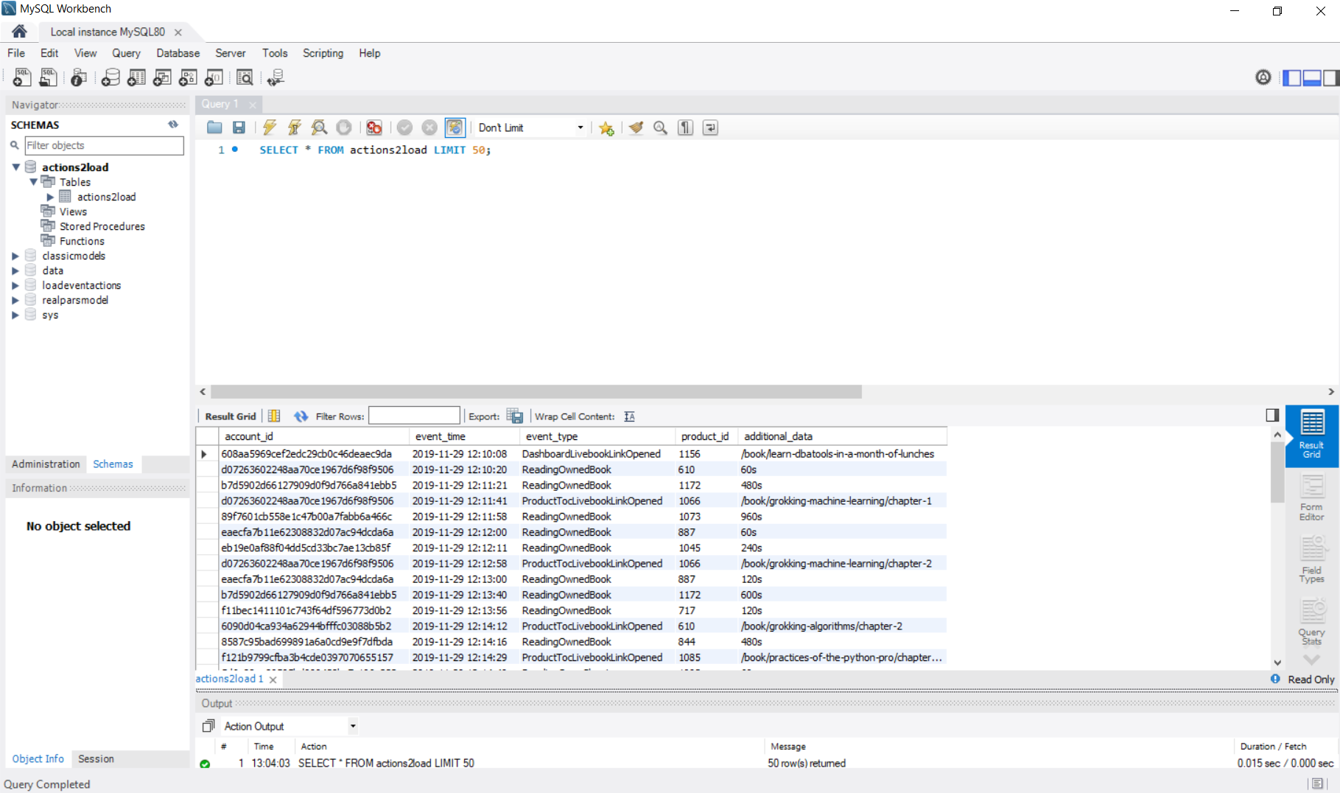
design -findings-analysis
2. Loading the whole CSV data into MySQL:

Slide 6
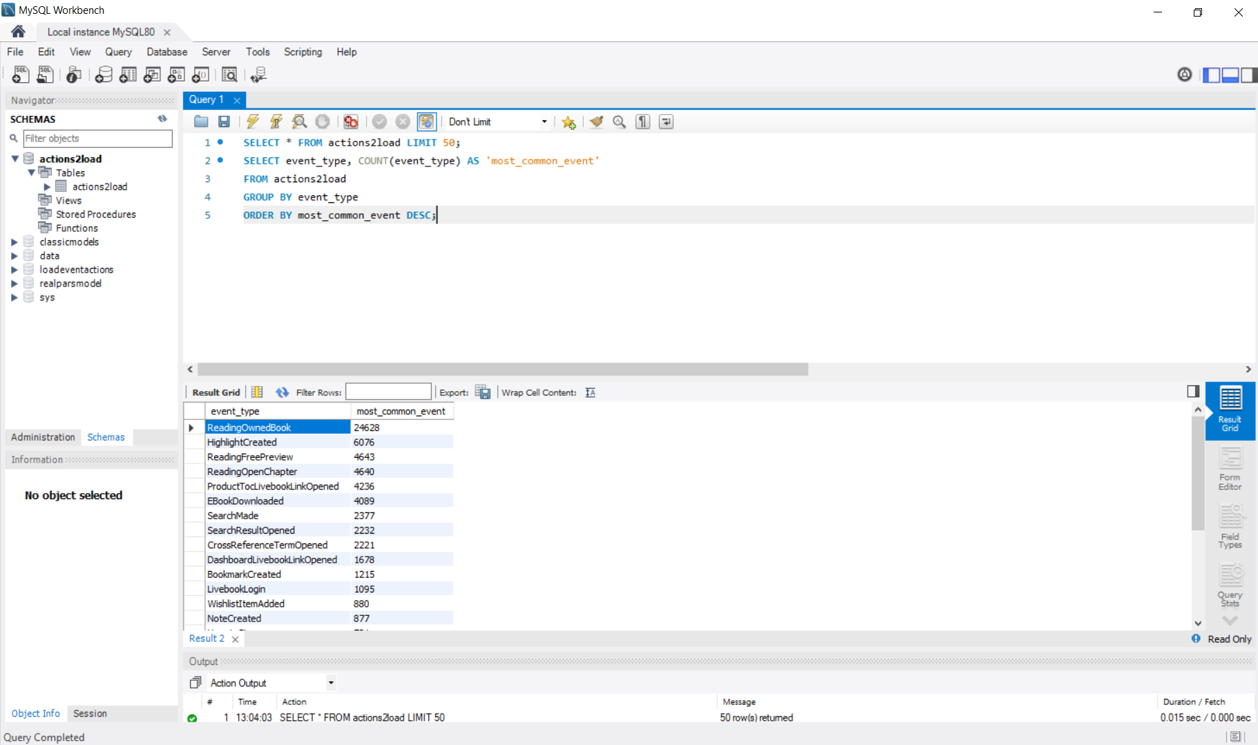
design -findings-analysis
3. Performing an SQL aggregation of the data to get an overview of what events are in the database, using SQL Queries:
What events are most common?
The “ReadingOwnedBook “ event type is the most common event, with ‘24628’ occurrences.

Slide 7
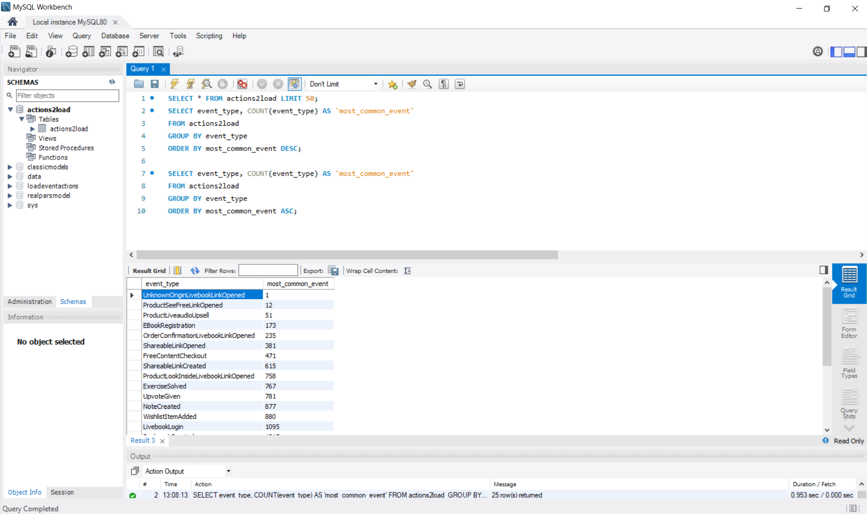
design -findings-analysis
3. Performing an SQL aggregation of the data to get an overview of what events are in the database, using SQL Queries:
What events are least common?
The least common event is the “UnknownOriginLivebookLinkOpened“ event type as shown in the query below.

Slide 8
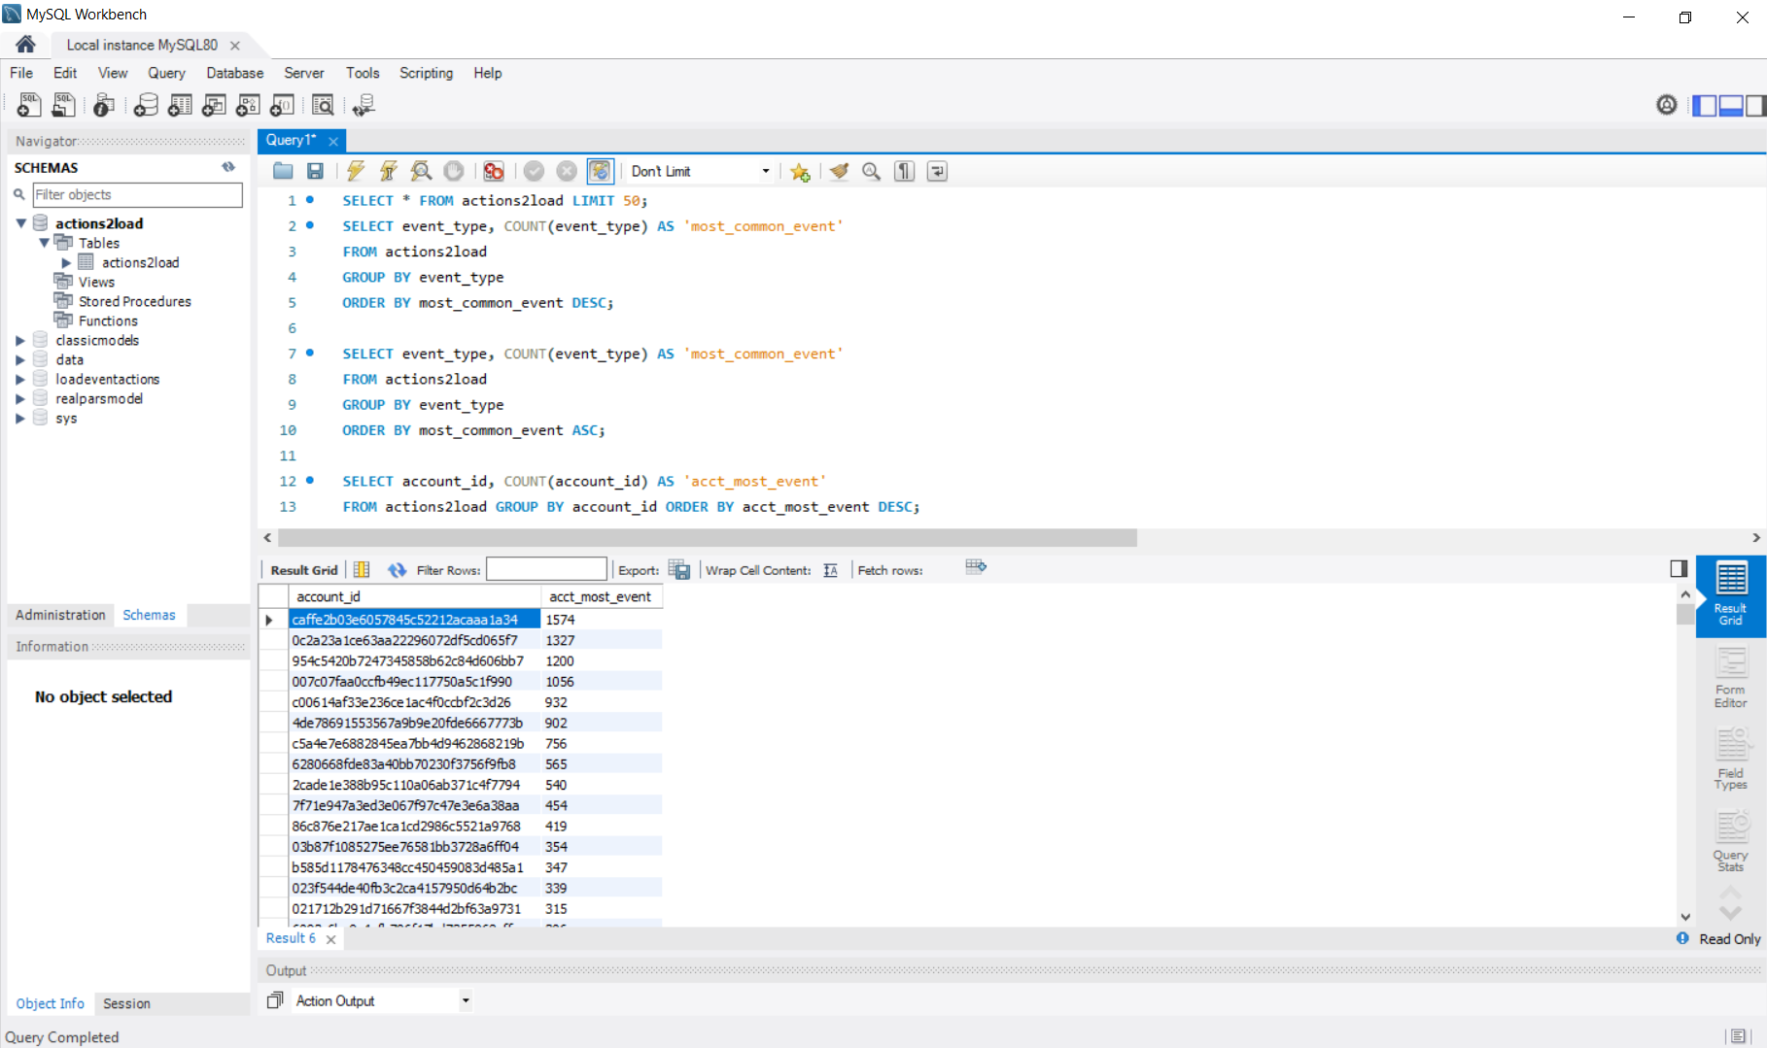
design -findings-analysis
3. Performing an SQL aggregation of the data to get an overview of what events are in the database, using SQL Queries:
Get the account id with the highest number of events :
The account id with the highest number of events is “caffe2b03e6057845c52212acaaa1a34” as shown in the query below:

Slide 9
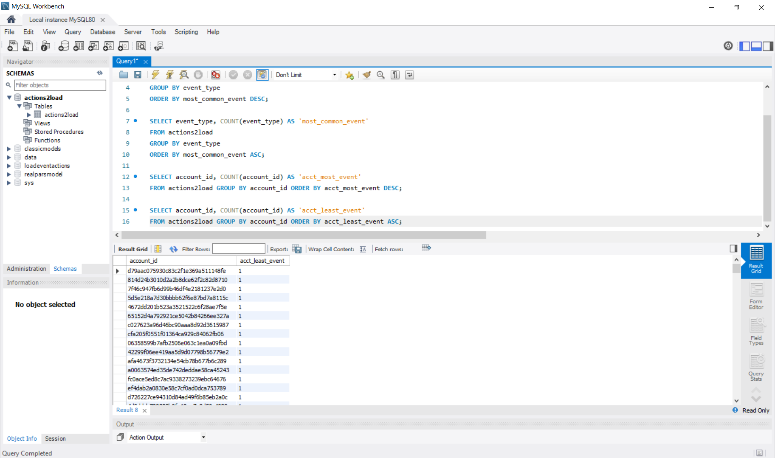
design -findings-analysis
3. Performing an SQL aggregation of the data to get an overview of what events are in the database, using SQL Queries:
The account id with the least number of events:
1503 account ids has the least number of events with one event occurrence each. The 1503 account ids ‘acctwithleastevent’

Slide 10
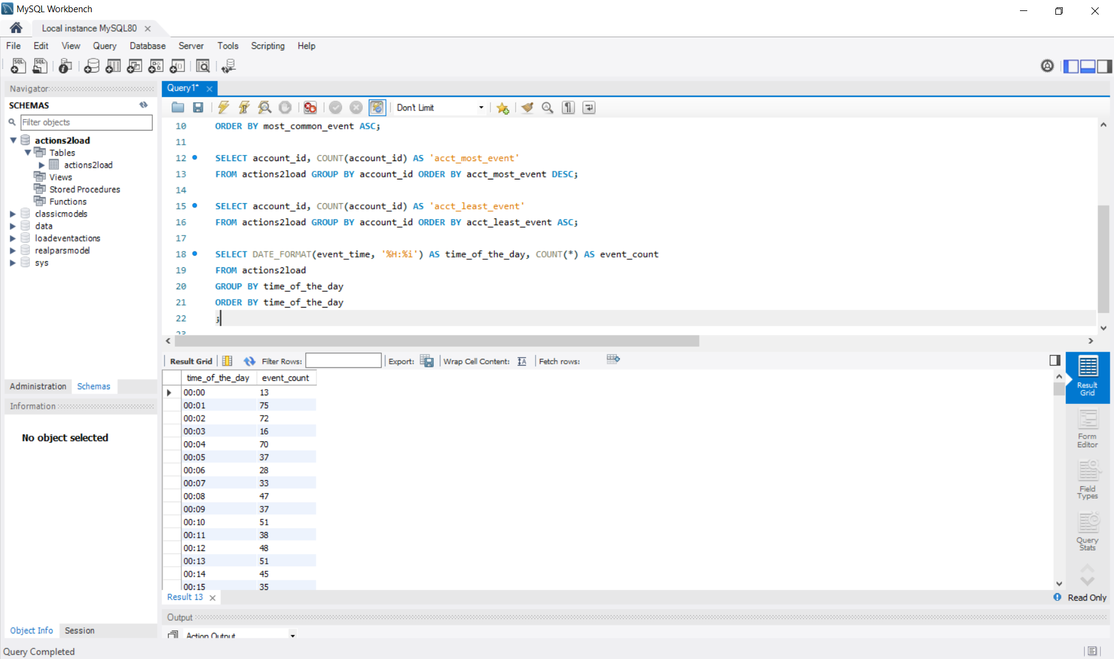
design -findings-analysis
3. Performing an SQL aggregation of the data to get an overview of what events are in the database, using SQL Queries:
How many times events occurred based on different times of the day:
Time events occur “timeeventoccur”

Slide 11

design -findings-analysis
4&5. Data quality assurance check using python
Check it out at: actions2load

Slide 12

THANK YOU

